Slide 1
The Link Layer and Attacks

Slide 2
Outline
Network Interface
Ethernet frame and MAC header
ARP protocol
ARP cache poisoning attack

Slide 3
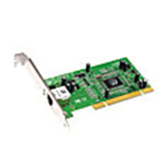
Link Layer
The link layer has responsibility of transferring datagram from one node to physically adjacent node over a link (on the same subnet)
Layer-2 packet: frame, encapsulates datagram
Link layer implemented in “adaptor” (aka network interface card NIC) or on a chip
Wired links (ethernet)
Wireless links (wifi)

Slide 4
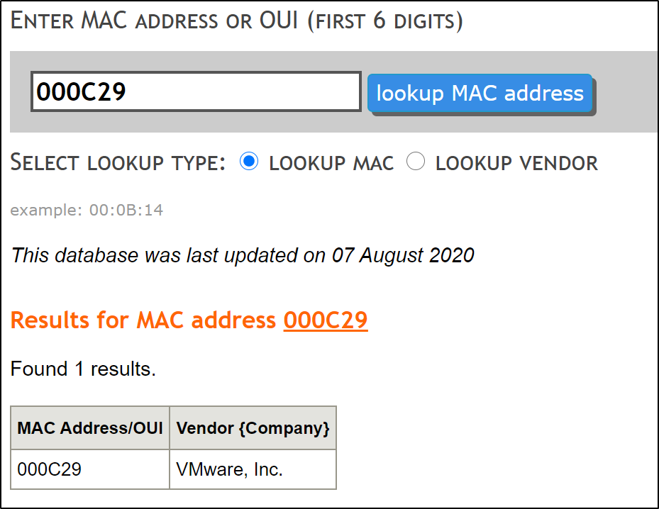
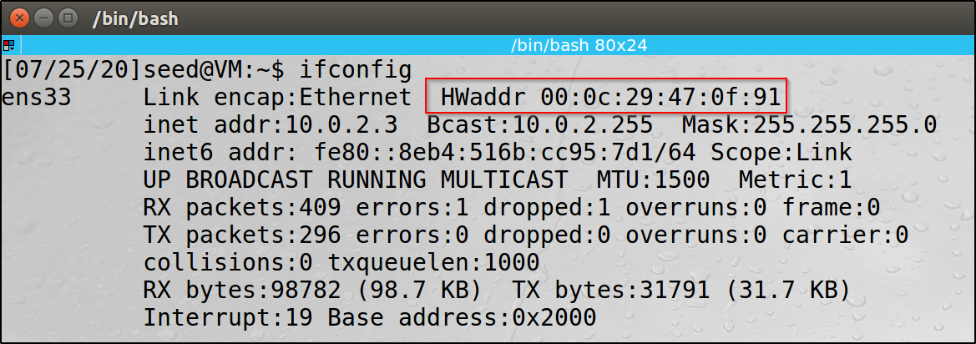
MAC Address
Each NIC has a hardware address: 48 bit MAC address burned in NIC ROM
Used to get frame from one interface (host) to another physically-connected interface (host) on the same LAN
Each adapter on LAN has unique MAC address

Slide 5
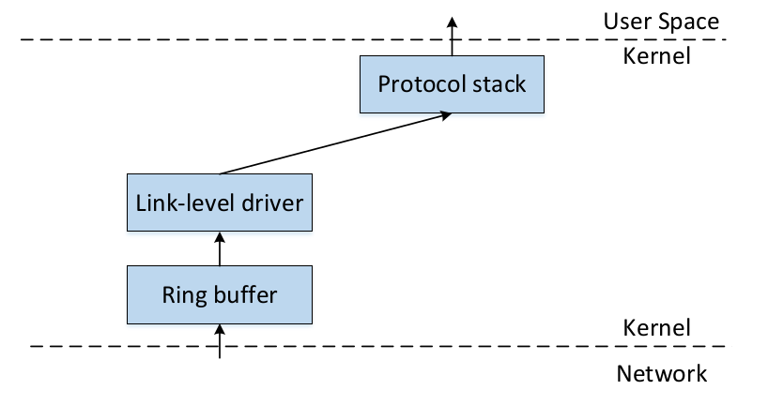
Packet Flow
Network Interface Card

Slide 6
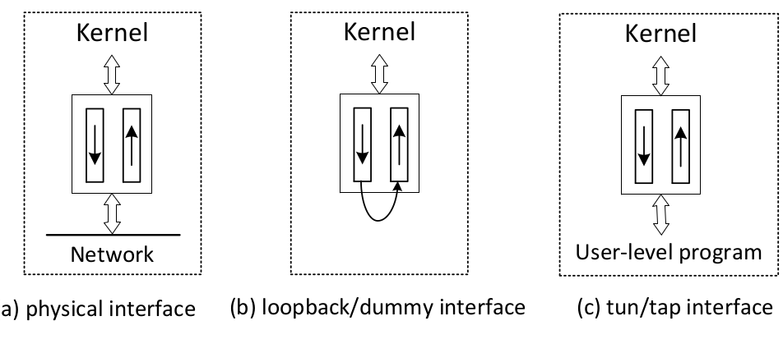
Physical and Virtual NIC
Notes:
One end of a NIC is the OS kernel (protocol stack). The other end can vary, especially for virtual NIC, which is implemented using software.

Slide 7
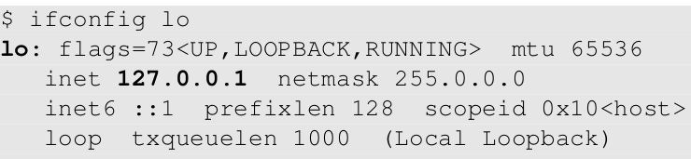
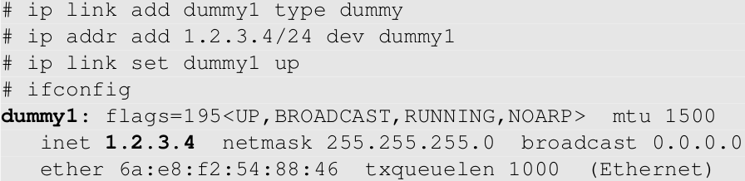
Examples of Virtual NIC
Loopback Interface
Dummy Interface (similar to loopback, but with its own IP)

Slide 8
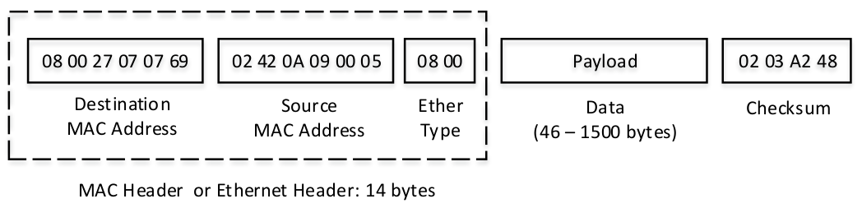
Ethernet Frame & MAC Header

Slide 9
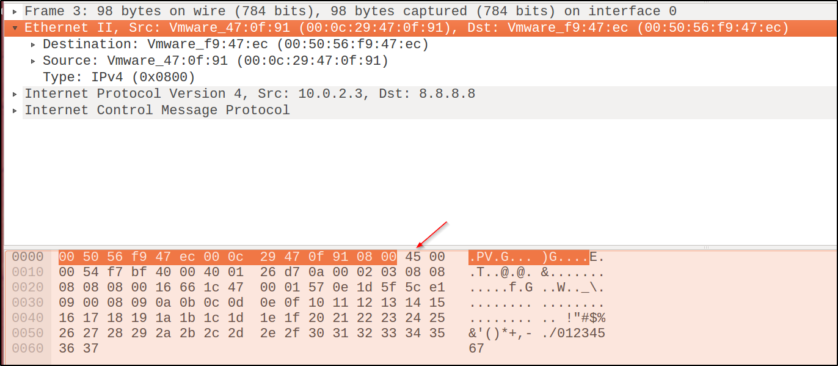
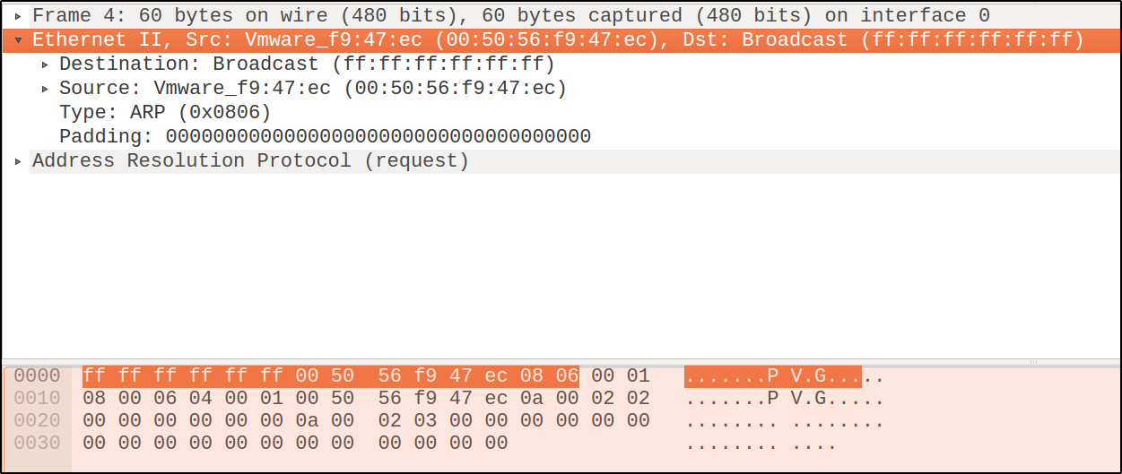
Ethernet Frame Examples

Slide 10
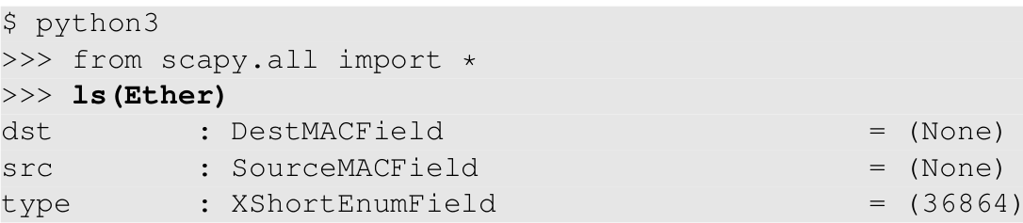
Ether Class in Scapy

Slide 11
Promiscuous Mode
Ethernet is a broadcast medium
NIC check destination MAC address
mine: accept the frame
not mine: discard it
Enable promiscuous mode
Will not check destination MAC
Take in all the packets on the local network
Useful for packet sniffing

Slide 12
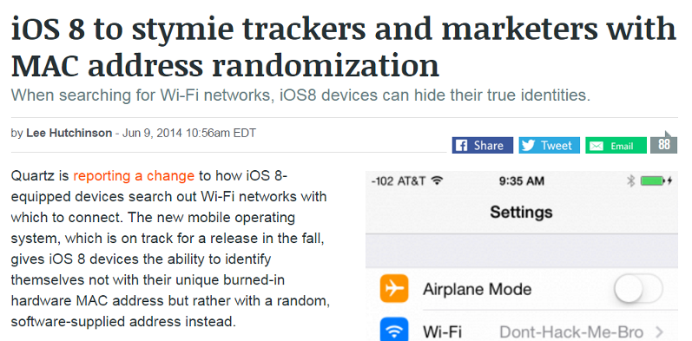
MAC Address Randomization and Privacy

Slide 13
The ARP Protocol
Communication on LAN
Need to use MAC address
But we only know the IP address
ARP: Address Resolution Protocol
Find MAC from IP

Slide 14
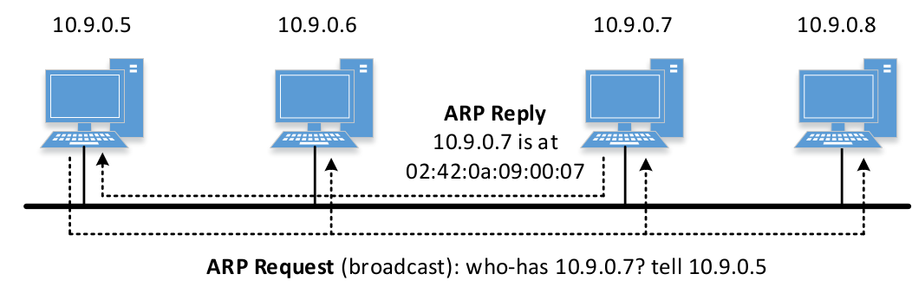
ARP Request/Reply

Slide 15
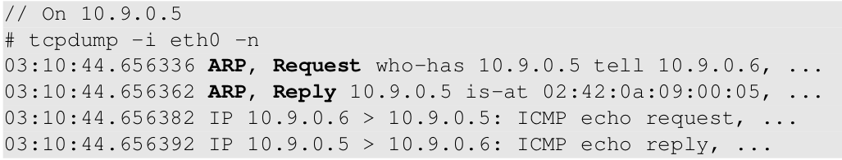
Send ARP Request
ping 10.9.0.5 from 10.9.0.6

Slide 16
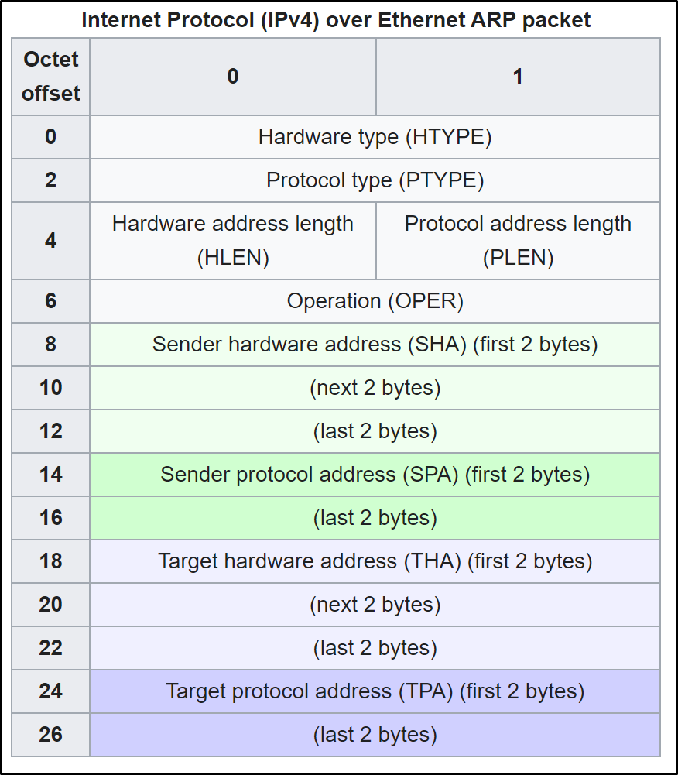
Address Resolution Protocol (ARP)
IP address (layer 3) → MAC Address (layer 2)
ARP is a stateless protocol
Hardware type (HTYPE): Ethernet is 1
Protocol type (PTYPE): IPv4 has the value 0x0800 (2048)
Hardware length (HLEN): Ethernet address length is 6 bytes
Protocol length (PLEN): IPv4 address length is 4 bytes
Operation: 1 for request or "who-has", 2 for reply or "is-at"
Source: wikipedia

Slide 17
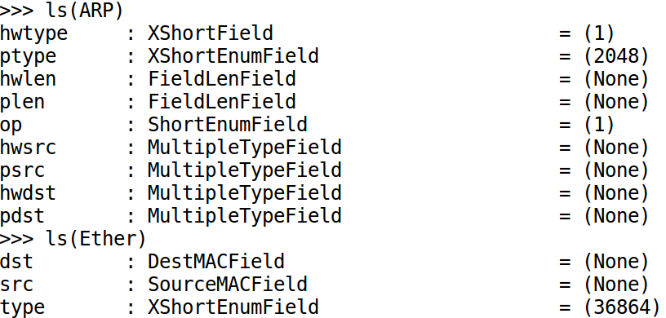
ARP Class in Scapy

Slide 18
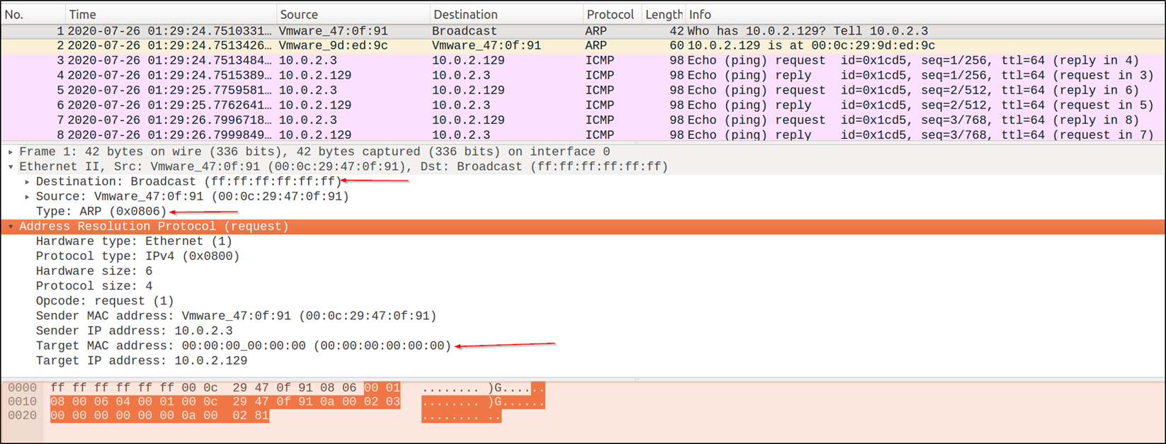
Sample ARP Request
Ping 10.0.2.129 from 10.0.2.3

Slide 19
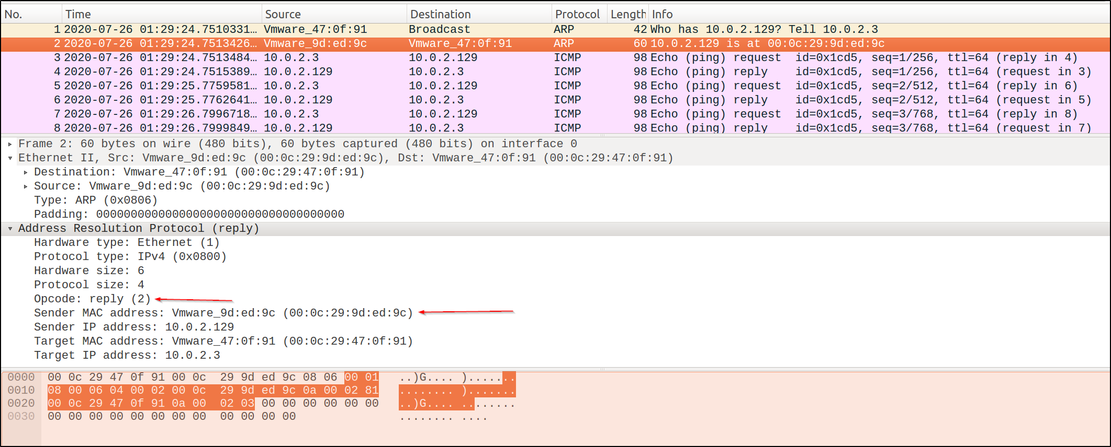
Sample ARP Reply

Slide 20
Questions
Different behaviors of the following commands
ping 10.9.0.6 (existing, on LAN)
ping 10.9.0.99 (non-existing, on LAN)
ping 1.2.3.4 (non-existing, not on LAN)
ping 8.8.8.8 (existing, on the Internet)
Notes:
before the ping packet (ICMP) is sent out, an ARP request will be sent out first.

Slide 21
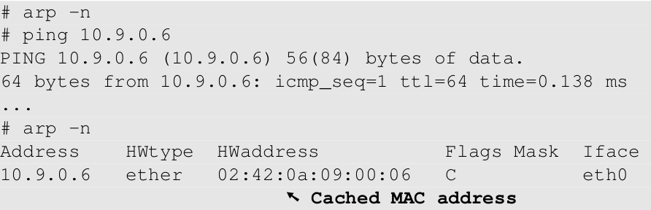
ARP Cache
Avoid sending too many ARP requests
ARP caches received information
empty cache

Slide 22
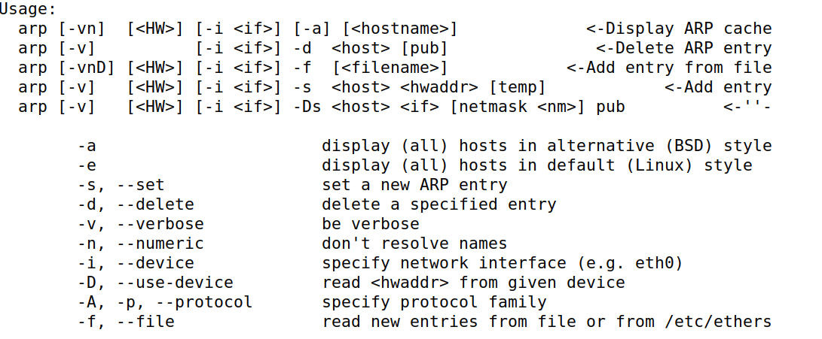
Linux ARP Command

Slide 23
ARP Cache Poisoning
ARP request
ARP reply
Gratuitous ARP packet
a special ARP request packet. It is used when a host machine needs to update its IP-to-MAC mapping to every host on the same network
The type can be either request or reply
The source and destination IP are both set to the IP of the machine issuing the gratuitous ARP and the destination MAC is the broadcast address ff:ff:ff:ff:ff:ff in both ARP header and Ethernet header. Ordinarily, no reply packet will occur
The attack can only be performed on the local network
What method is effective depends on the OS implementation

Slide 24
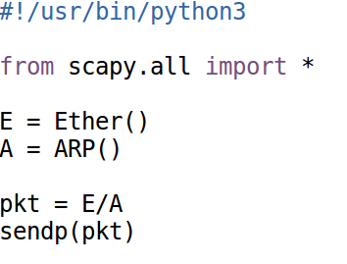
Constructing ARP Message
Construct ARP packet
Fields of ARP and Ether Class

Slide 25
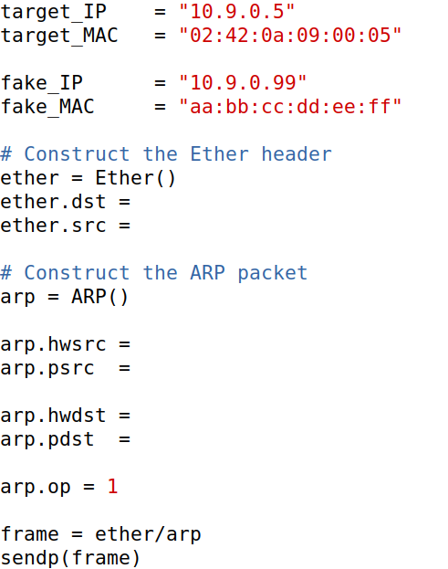
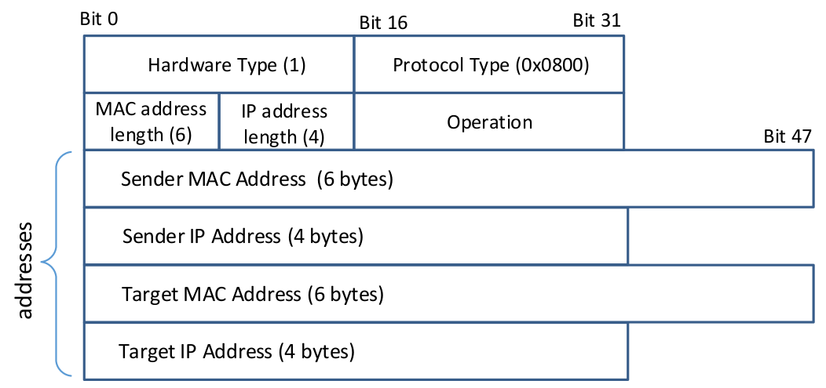
Spoof ARP Request/Reply: Code Skeleton
victim: 10.9.0.5
goal: map 10.9.0.99 to aa:bb:cc:dd:ee:ff

Slide 26
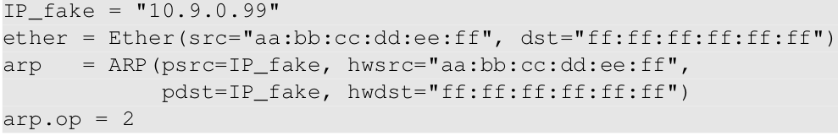
Spoofing Gratuitous Message
Special type of ARP message
Source IP = Destination IP
Destination MAC = broadcast address (ff:ff:ff:ff:ff:ff)

Slide 27
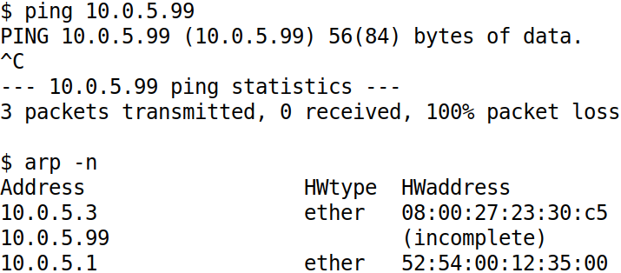
Note: ARP Becomes “Stateful”

Slide 28
A Question
If an ARP entry is not in the ARP cache, certain type of ARP cache poisoning attacks will fail. How can you trigger the victim to add an entry you’d like to poison into the cache?
Notes:
The victim issues a ping to the host which the attacker would like to provide a fake IP/MAC translation
The attacker spoof (pretending to be the host which the attacker would like to provide a fake IP/MAC translation ) an ICMP echo request to be sent to the victim

Slide 29
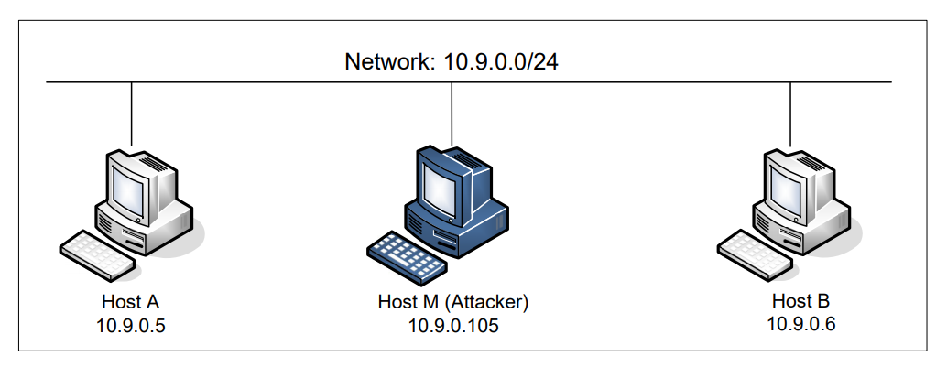
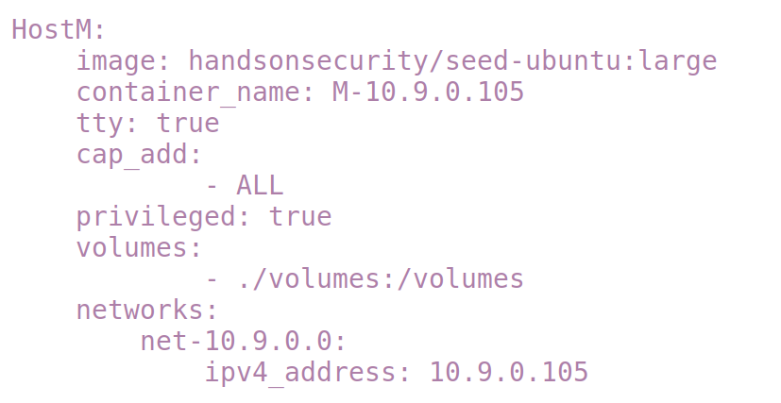
MITM via ARP Cache Poisoning
sysctl net.ipv4.ip_forward=0
IP Forwarding = 0 sniff and spoof

Slide 30
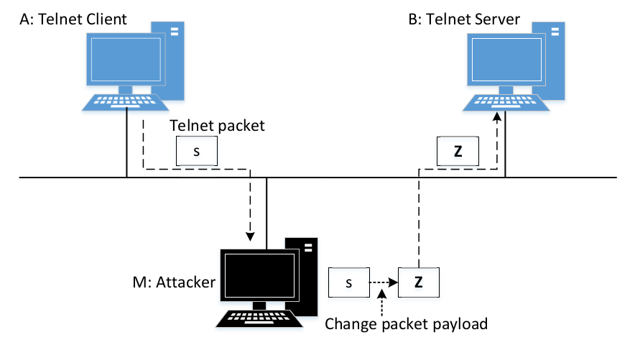
Man-In-The-Middle Attack

Slide 31
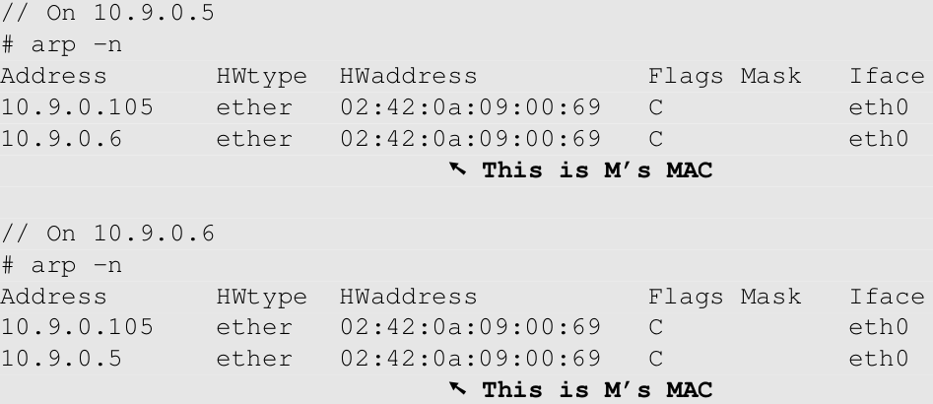
Use ARP Cache Poisoning to Redirect Packets
Poison A’s ARP cache, so B’s IP is mapped to M’s MAC.
Poison B’s ARP cache, so A’s IP is mapped to M’s MAC.
Machine A
Machine B

Slide 32
Forward Packets without Modification
Enable/Disable IP Forwarding
sysctl net.ipv4.ip_forward=1
sysctl net.ipv4.ip_forward=0

Slide 33
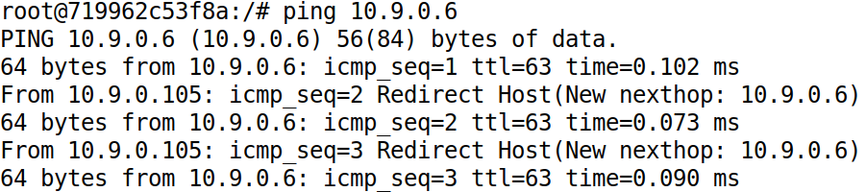
Demo
With IP forwarding on

Slide 34
MITM Step 1: Intercept Packets
Disable IP Forwarding
sysctl net.ipv4.ip_forward=0
How to Get the packet on M?
Notes:
Using sniffing

Slide 35
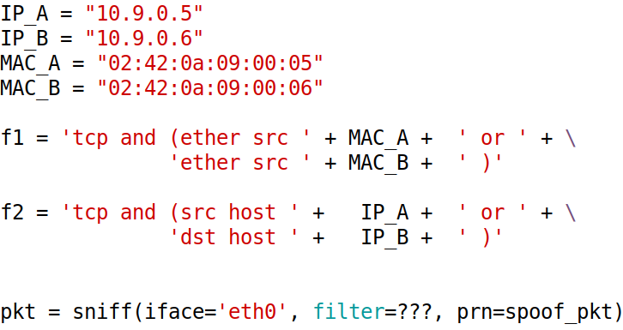
MITM Step 2: Get the Intercepted Packets
Question: which filter should we use, f1 or f2?
Notes:
See the discussion in the Book

Slide 36
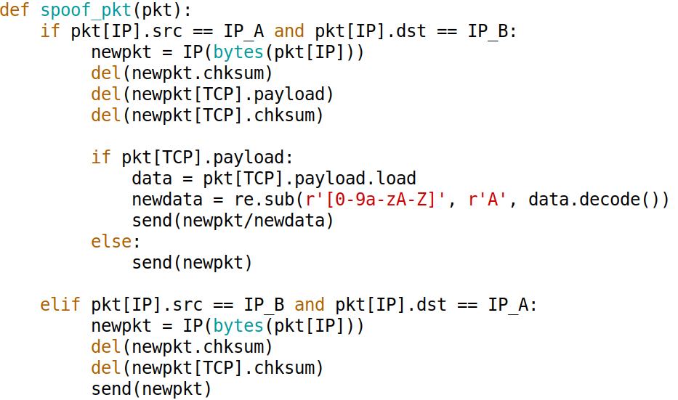
MITM Step 3: Modify Packets

Slide 37
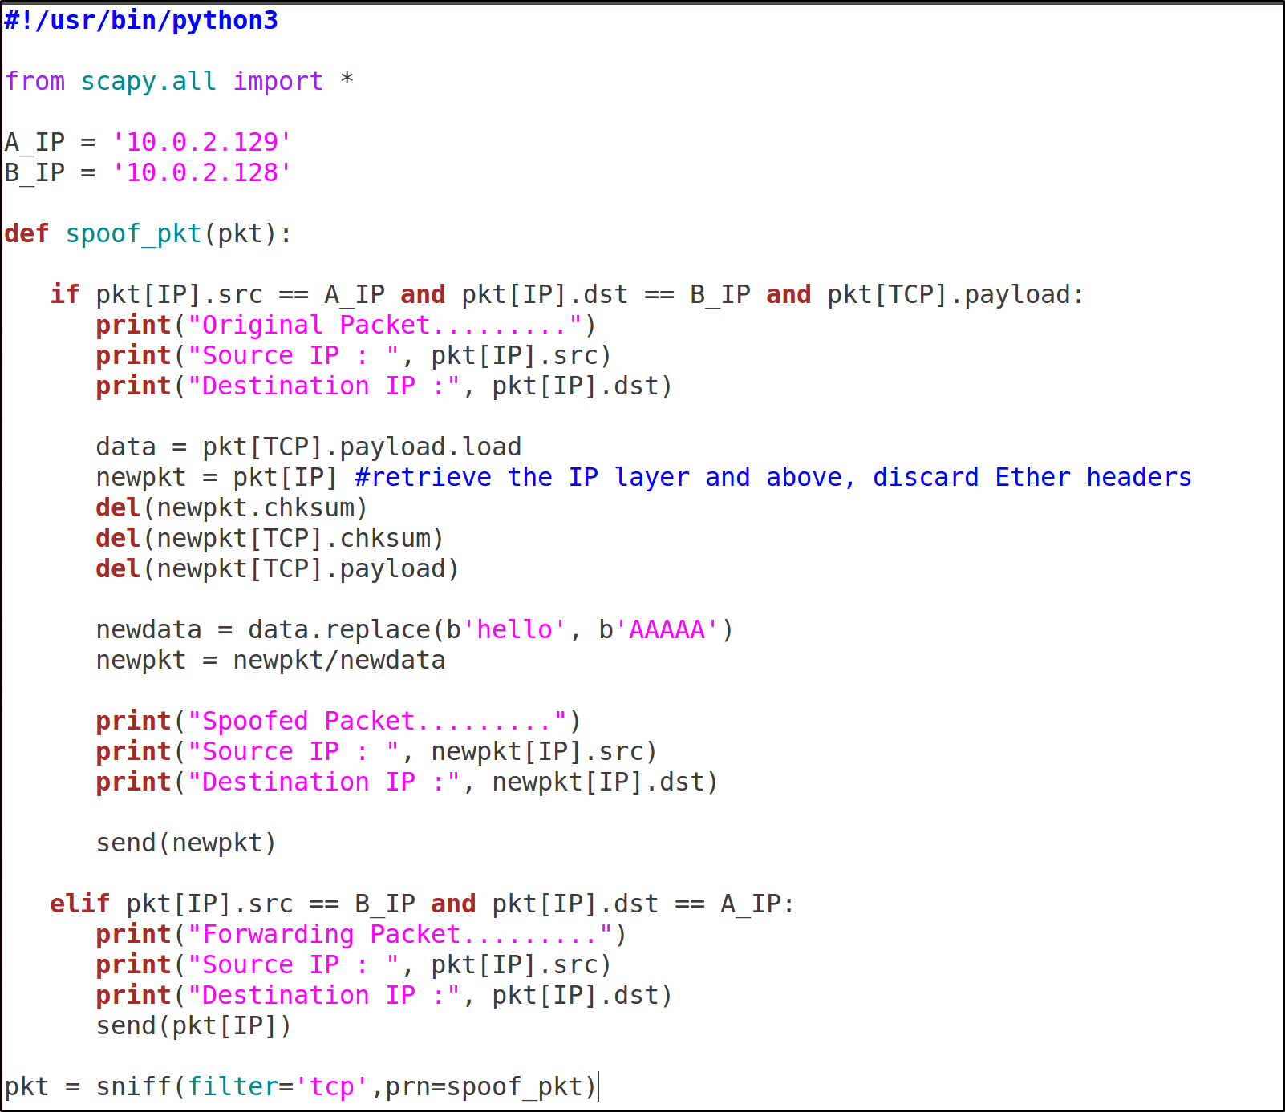
ARP MITM Attack on Netcat

Slide 38
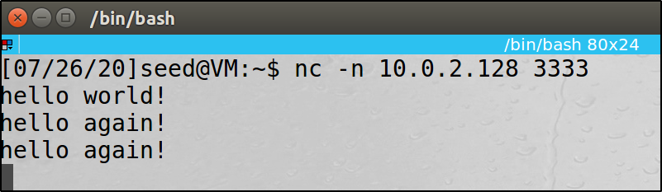
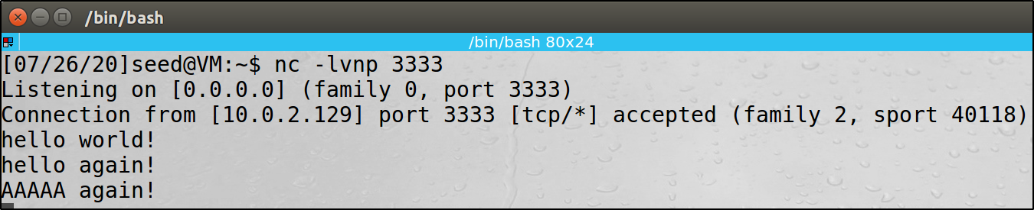
ARP MITM Attack on Netcat

Slide 39
Questions
In stead of hijacking the communication between two local hosts on the same LAN, you’d like to hijacking the communication between any local host on the LAN and a remote host on the Internet. How can you use ARP cache poisoning to accomplish the goal?
In January 2020’s Board meeting, Bob, xyz.com’s CIO claimed that in 2019 under his leadership, the company had successfully defeated over 100 ARP cache poisoning attacks launched from Russia against xyz’s internal networks. If you are one of the board members, do you agree with Bob’s claim or not?
Notes:
1. Perform the ARP cache poising on the gateway router

Slide 40
Countermeasure
Encryption
Can we conduct MITM attack against FTP, Telnet and SSH?

